Slide 1


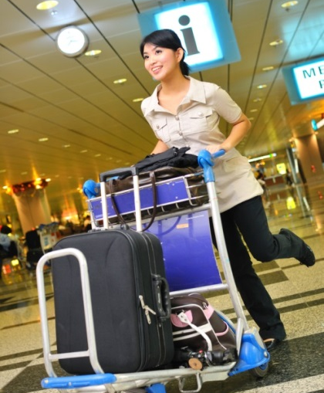



PROVIDE ARRIVAL AND DEPARTURE ASSISTANCE
D2.TTG.CL3.17
Notes:
Trainer welcomes students to class.

Slide 2

Subject elements
This unit comprises two Elements:
Provide assistance for arrival passengers
Provide assistance for departure customers
Notes:
Trainer advises this Unit comprises two Elements, as listed on the slide explaining:
• Each Element comprises a number of Performance Criteria which will be identified throughout the class and explained in detail
• Trainees can obtain more detail from their Trainee Manual
• At times the course presents advice and information about various protocols but where their workplace requirements differ to what is presented, the workplace practices and standards, as well as policies and procedures must be observed.

Slide 3

Assessment
Assessment for this unit may include:
Oral questions
Written questions
Work projects
Workplace observation of practical skills
Practical exercises
Formal report from supervisor
Notes:
Trainer advises that assessment for this Unit may take several forms all of which are aimed at verifying they have achieved competency for the Unit as required.
Trainer indicates the methods of assessment that will be applied to them for this Unit.

Slide 4

Element 1: Provide assistance for arrival passengers
Performance Criteria for this Element are:
1.1 Check itinerary of arriving passengers to identify and action alterations as required
1.2 Confirm transport arrangements, where applicable
1.3 Greet passengers
1.4 Provide local information to passengers
1.5 Advise passengers regarding check-in procedures at accommodation venues, where appropriate
1.6 Direct passengers to appropriate transport location for transfer
(continue)
Notes:
Trainer identifies the Performance Criteria for this Element, as listed on the slide.

Slide 5
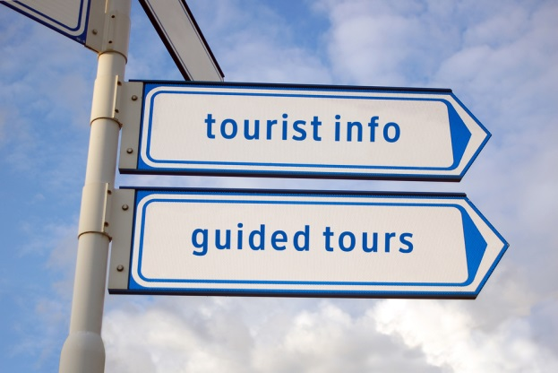
Element 1: Provide assistance for arrival passengers
Performance Criteria for this Element are:
1.7 Use terminal facilities to assist in meeting arriving passengers
1.8 Record passenger arrivals and other comments
1.9 Facilitate movement of baggage from terminal to meet passenger needs
1.10 Follow lost baggage procedures, where required
1.11 Liaise with staff from other businesses to facilitate passenger arrival at, and use of, their products and services
Notes:
Trainer identifies the Performance Criteria for this Element, as listed on the slide.

Slide 6
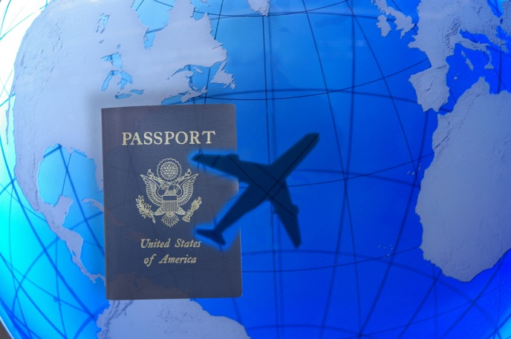
1.1 Check itinerary of arriving passengers to identify and action alterations as required
Check itinerary of arriving passengers may be related to:
Identifying names and carriers of incoming passengers
Comparing known itinerary against known changes to scheduled transportation, such as delays, cancellations and re-routing
Determining whether or not changes need to be made to scheduled transportation
Notes:
Brainstorm each point within small groups providing 1-2 examples or brainstorm as a class incorporating personal experience or knowledge of similar situations

Slide 7

1.1 Check itinerary of arriving passengers to identify and action alterations as required
Check itinerary of arriving passengers may be related to:
Contacting carriers to make appropriate changes on behalf of the passenger
Noting possible options for changes to scheduled transportation to present to passenger
Notes:
Brainstorm each point within small groups providing 1-2 examples or brainstorm as a class incorporating personal experience or knowledge of similar situations

Slide 8

1.1 Check itinerary of arriving passengers to identify and action alterations as required
STOP! Do you have all the details to receive your visitors at the transport terminal?
What do you need to know?
Notes:
Brainstorm this to encourage participation and engagement in the topic. Emphasise the importance of arriving prepared.
Answers on next slide

Slide 9
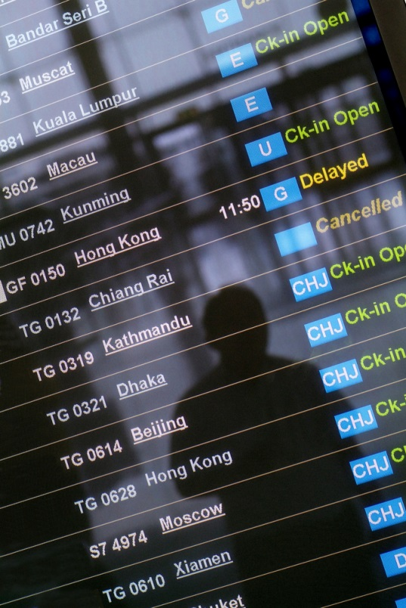
1.1 Check itinerary of arriving passengers to identify and action alterations as required
Visitors’ name list
Arrival time, delays and cancellations
Terminal and Gate number
Baggage Claim Belt Numbers
Type of Tour:
Independent Vacation
Guided/Hosted Tour
Length of Tour
Time Schedule
Anything else?
Notes:
Check for any other good suggestions by learners.

Slide 10


1.2 Confirm transport arrangements, where applicable
Confirming transport arrangements will include:
Contacting carrier
Verifying that scheduled transportation is confirmed by date, time and departure destination
Notes:
Discuss what needs to be talked through for each of these points.

Slide 11

1.2 Confirm transport arrangements, where applicable
When aiming to build rapport and friendship with the transport representative especially the drivers, you are required to contact and brief them on the arrangements for the arrival of visitors. Information required is:
Your name
Profile of visitors
Arrival information
Tour route and destination
Notes:
Discuss why each of these points is important. (Continue on next slide as well)
Discuss and brainstorm in further detail what details can be raised with bullet points 2-4
Your name – your full name, present business card, inform of abbreviated or other name you may prefer to be known as
Profile of visitors – who the travellers are today, ethnicity, age group, destination preferences, length of stay…..
Arrival information – arrival, confirm accommodation location
Tour route and destination – confirming best route for travel and both be agreeable on this.

Slide 12
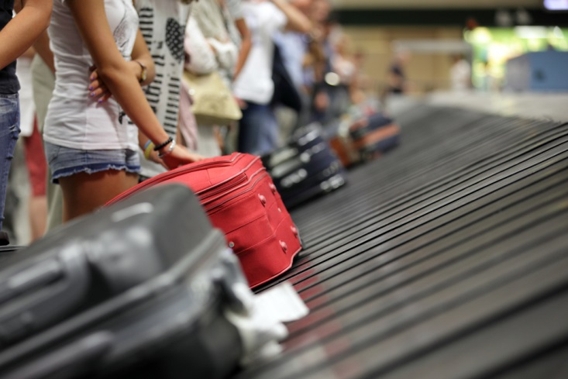
1.2 Confirm transport arrangements, where applicable
How are we going to ensure that all visitors’ luggage is collected and safely placed in the transport vehicle?
Confirming with the driver if there are any known delays or detours to tour routes
(Continued)
Notes:
Discuss why each of these points is important.

Slide 13

1.2 Confirm transport arrangements, where applicable
The driver should have a printed detailed attendance list so at every stop whether it is for a toilet break, custom checkpoint, emergency or any other reason, all visitors’ attendance is checked and reported back to the travel agency for visitor safety
Notes:
Discuss why this point is important.

Slide 14

1.3 Greet passengers
Greet passengers may include:
Welcoming passengers
Encouraging feelings of goodwill
Building rapport with the passengers
Employing appropriate interpersonal skills
Notes:
Discuss the importance of this and the impact the greeting may have on the overall mind set of customers.
Use the acronym ‘GST’ (greet, smile, thank)as a memory training tool
Ensure trainees understand ‘rapport’ and ‘interpersonal’ skills
Discuss grooming and dress – what is appropriate (may have already covered this several times in other units)
Discuss body language and voice control
Indicate to learners that they will now be asked to demonstrate how they will greet their passengers
Activity – Greet Passengers allow 15-30 depending how in-depth. Could be done within groups, or to the class

Slide 15
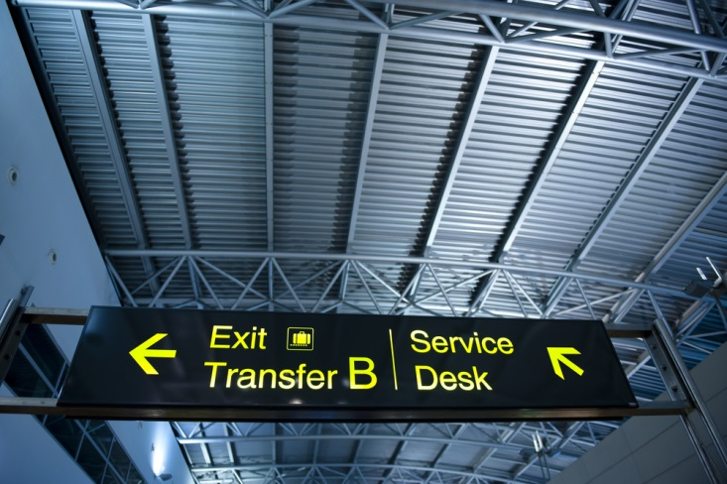
1.4 Provide local information to passengers
What would you consider local information upon arrival?
Terminal Transfer
Location of washrooms
Documentation required upon arrival
Meeting points to prepare for boarding coach/car
Check of personal belongings and luggage to ensure that all items are accountable for
Notes:
The Trainee manual reflects some key points for discussion upon first meeting visitors.
There is animation on bullet points. Answers will ‘fade in’
Brainstorm or small groups to provide suggestions before revealing answers.
Discuss trainee answers further as needed.

Slide 16

1.4 Provide local information to passengers
What would you consider local information?
Local map and tourism brochures
Time and Date , Climate, weather forecast
Geography, Government, Economy
History, Culture, Heritage
Food, Shopping, Currency Exchanges Rates
Transportation and Fares
Name and Location of Hotel, Hotel Facilities and Amenities
Tipping custom
Notes:
There is animation on bullet points. Answers will ‘fade in’.
In small groups use flip charts to create a list. Each group to present their thoughts. Discuss and review as needed.

Slide 17


1.5 Advise passengers regarding check-in procedures at accommodation venues, where appropriate
Accommodation may include:
Hotels, motels and guest houses
Resorts and bed and breakfast providers
Caravan parks and camping grounds
Notes:
Discuss learners understanding of each type of accommodation before referring to notes. Not all accommodation is popular or available in Asia.

Slide 18
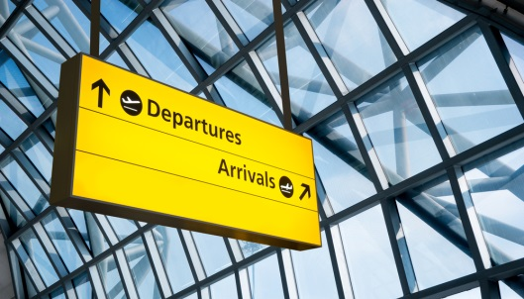

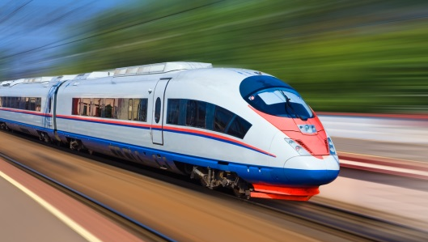

1.6 Direct passengers to appropriate transport location for transfer
What comes to mind when we refer to ‘transport’?
Airports
Bus and Coach terminals
Train stations
Shipping ports
Notes:
There is animation on bullet points. Answers will ‘fade in’.
Based on location for training learners may have quite varied experience with each point. Discuss this and the size of the transport terminal they are familiar with. I.e. Capital city, major town or village. Perhaps discuss some of the busiest transport terminals in the world
Airports-JFK, Heathrow
Cruise ports-Spain, Italy, Florida-USA, Caribbean, Mexico, Singapore
Train stations – All major Stations in Japan, Gare du Nord, France, Penn Station New Jersey, USA, Zurich Station Switzerland, Union Station Canada
Bus Stations –see website http://nobert-bermosa.blogspot.com.au/2011/08/world-record-holders-most-remarkable.html

Slide 19
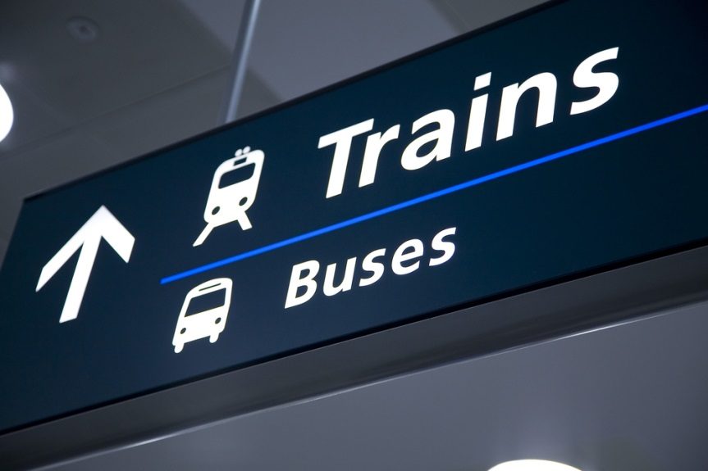
1.7 Use terminal facilities to assist in meeting arriving passengers
Terminal facilities may include:
Public address systems
Airside access
Designated group meeting areas
Internal communication systems between terminal and parking facilities
Notes:
Discuss and confirm understanding of each point.
If possible allow trainees to experience speaking into a microphone or megaphone.
Alternatively discuss do’s and don’ts when the voice is amplified.
Discuss each point based on knowledge and experience. Seek input from learners on previous experience.

Slide 20

1.8 Record passenger arrivals and other comments
Record passenger arrivals may include:
Using internally generated documentation, such as an Arrivals List, to verify actual arrival of passenger
Noting time of arrival, where required
Recording passengers who do not arrive as a ‘No Show’
Including details of reason for No Show, where known
Noting accompanying baggage for each passenger, where required
Notes:
Discuss as needed identifying key points and their importance.
Where possible have a sample of an Arrivals List for viewing.

Slide 21

1.9 Facilitate movement of baggage from terminal to meet passenger needs
Establishing transport arrangements for baggage
Transporting luggage
Matching movement of baggage to locations in accordance with schedules/passenger movement
Using checking procedures to ensure the correct baggage is transported for the appropriate passenger, including baggage tagging and recording
Notes:
Discuss each point and its importance or relevance. Link back to the Arrivals list where the pieces of luggage are listed as well.
Information on a luggage tag: (if possible have luggage tag samples available)
Agency name and contact details
Colour codes for specific purposed(these may vary depending on tour operator)
Name of visitor
Destination for luggage to be transported to
Special requirements such as ‘Fragile – Handle me with care’, ‘Heavy’ notifications.
For bullet point #2 ensure an understanding of carry-on luggage allowances and why they are limited. Importance of declaring fragile items and what would come under miscellaneous fees.

Slide 22
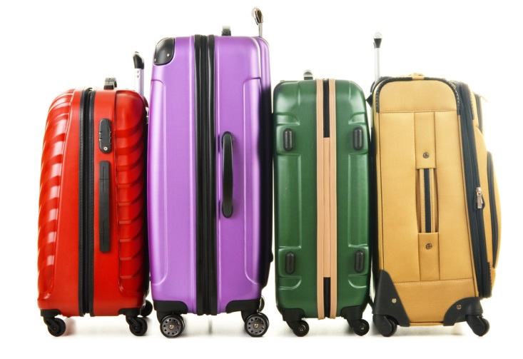
1.9 Facilitate movement of baggage from terminal to meet passenger needs
Supervising movement of baggage
Check luggage storage compartment
Ensure that all visitors’ luggage is being tracked and handled correctly
Indemnity form
Notes:
Discuss each as needed.
Luggage tracking – computerised methods available today utilizing barcodes. Reminder that it is the Tour Guide’s responsibility to double check all luggage is accounted for before the transport driver departs or the Bell Attendant transfers to rooms.
Have a sample ‘indemnity form’ for viewing. Discuss and identify its importance

Slide 23

1.10 Follow lost baggage procedures, where required
Follow lost baggage procedures may include:
Recording details and description of baggage claimed to have been lost
Capturing details of the passenger, including their next destination, duration at that location and immediate ongoing itinerary
Conducting immediate search for the baggage
Notifying other staff to involve them in the baggage search
Apologising to passenger
(Continued)
Notes:
Discuss: there are many points that may need to be covered with the passenger depending on your company policy so it is important to be familiar with it.
Is there any experience in the room regarding lost luggage? Was it found? How were you looked after?
Indicate that we will now look at a few points in more detail. Trainer to decide on which points and how many based on time allowance

Slide 24

1.10 Follow lost baggage procedures, where required
Follow lost baggage procedures may include:
Providing passenger with host enterprise on-the-spot compensation, where applicable
Advising passenger regarding claims procedure against the company
Advising passenger regarding insurance claims, where applicable
Advising passenger regarding applicable terms and conditions
Comforting passenger
Notes:
Discuss: there are many points that may need to be covered with the passenger depending on your company policy so it is important to be familiar with it.
Is there any experience in the room regarding lost luggage? Was it found? How were you looked after?
Indicate that we will now look at a few points in more detail. Trainer to decide on which points and how many based on time allowance

Slide 25

1.10 Follow lost baggage procedures, where required
Identify the arriving terminal and its handling agent
Transport Terminal Air: Lost and Damaged Luggage Procedures
Conduct immediate search with agency and other staff
Conduct an investigation
Assist with insurance claim
Complete an incident report
Notes:
What is the role of a Handling Agent
Review samples of Lost luggage procedure from Changi airport in Trainee manual
Identify limitations for passengers regarding baggage liability in manual
Discuss what may be involved in a search and the importance of taking notes and names of staff in order to complete an investigation and incident report.
If possible have a sample of ‘Incident Report’ for viewing. This could be made an activity where small groups need to role play the situation.

Slide 26

1.11 Liaise with staff from other businesses to facilitate passenger arrival at, and use of, their products and services
Liaise with staff from other businesses:
Notifying other businesses that passengers have arrived at the terminal
Providing group details as appropriate
In order for visitor’s travel arrangements to run smoothly it is vital clear communication be maintained between the parties concerned:
How will you do this?
Notes:
Discuss types of businesses this would involve and the different details they may require to provide the product or service ordered.
This could be made an activity where small groups need to identify an arrival situation (elderly tour group, private family group, business group or other) and detail their communications and present to the class. Emphasise this type of presentation assists with gaining experience in announcing or providing information in a group situation.
Complete Work Projects for this Element from Trainee Manual as time allows either individually or in work groups. If no time then direct learners to complete as homework.

Slide 27

Element 2: Provide assistance for departure customers
Performance Criteria for this Element are:
2.1 Check itinerary of departing passengers to identify and action alterations as required
2.2 Organise the departure of passengers from their location
2.3 Verify departing passengers using a departures list
2.4 Facilitate movement of baggage from departing passenger location to terminal
(Continued)
Notes:
Trainer identifies the Performance Criteria for this Element, as listed on the slide.

Slide 28

Element 2: Provide assistance for departure customers
Performance Criteria for this Element are:
2.5 Advise departing passengers regarding legal and other procedures applying to their departure
2.6 Solicit feedback from departing guests on products and services
2.7 Facilitate check-in of departing passengers at the terminal
Notes:
Trainer identifies the Performance Criteria for this Element, as listed on the slide.

Slide 29

2.1 Check itinerary of departing passengers to identify and action alterations as required
Check itinerary of departing passengers may include:
Identifying names of departing passengers and carriers
Comparing known itinerary against known changes to scheduled transportation arrangements, such as delays, cancellations, re-routing
Determining whether or not changes need to be made to scheduled transportation
(Continued)
Notes:
Discuss points (continued on next slide) as time allows. This could be done as an activity. Divide class into small groups. Each group to work through bullet points providing information, samples, options as required for each point. The purpose is to have scenarios where changes need to or must be changed and learners are to provide solutions.

Slide 30

2.1 Check itinerary of departing passengers to identify and action alterations as required
Check itinerary of departing passengers may include:
Contacting carriers to make appropriate changes on behalf of the passenger
Noting possible options for changes to scheduled transportation to present to passenger
Confirming with carriers that scheduled transportation arrangements still apply and are ‘good to go’
Notes:
Work through each of these points to confirm participant comprehension

Slide 31
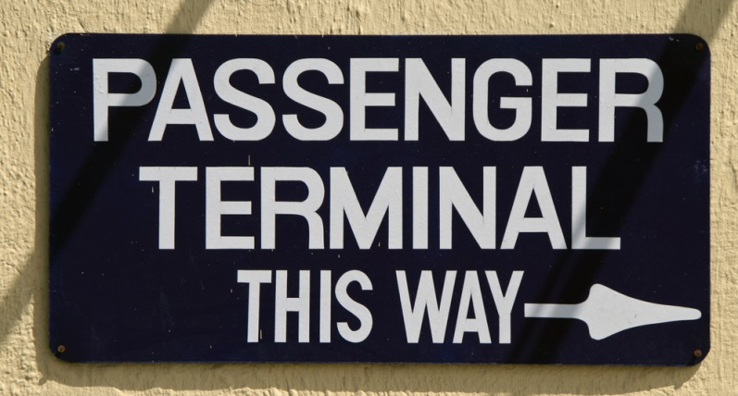
2.1 Check itinerary of departing passengers to identify and action alterations as required
Departure list
Passenger and baggage check-in
Terminal and Gate number
Departure time, delays and cancellations
Notes:
Discuss what would be checked and confirmed before meeting departing visitors.
Case Scenario:
A group of 28 pax from ABC Travel are spending their last two nights at Furama Riverfront Hotel. Michael Yeo is the tour agent representing the agency and he has been with the visitors for the past three days. They are now on their last two nights; Michael has to check and prepare several arrangements before the departure.
Based on this scenario, you are to answer all of the following questions.
Question 1: Design a flow chart for all procedures required when preparing for departure of visitors.
Question 2: Explain the importance of such preparation and list the personnel to collaborate with.
Question 3: List three possible issues faced while preparing for departure of visitors.
Possible answer Q2;
Being prepared or preparation plan before executing, will benefit your professionalism and company brand. “Good Customer Service” principle is the first and last impression last.
Possible answer Q3;
Flight delay due to unforeseen circumstances and Visitors will be stranded in Airport
No Transportation available due to festive seasons
High volume turnover at the Hotel where they could not accommodate late check-out.

Slide 32

2.2 Organise the departure of passengers from their location
Consider the details that need to be organised and confirmed in order to assist visitors depart efficiently.
As a group or at you table discuss what might be the first points on your checklist.
Notes:
Activity : Learners are to arrange a checklist of details simulating organising passenger departure.
Trainer to indicate the following details specific to the country location you are in
A flight and destination. Day and date
Number of passengers (pax)
A hotel
Briefing notes for passengers on transfer details (utilise trainee manual notes)
Trainees are to present to the class/remainder of their work group
Trainer may choose to make this simple or more detailed depending on group size and time available. This activity can be combined with Trainee Manual role play for this Performance Criteria.

Slide 33

2.3 Verify departing passengers using a departures list
Verify departing passengers may include:
Checking departing passengers against documentation, such as a Departures List and/or Passenger Manifests
Confirming the identity of departing passengers
Checking the documentation of departing passengers
(Continued)
Notes:
The organising of the guest has been completed now the Departures List needs to be verified.
Departure list
Identity, documents and luggage
Conduct a manual head count
Itinerary update
Activity - GROUP DISCUSSION (from Trainee Manual)
Instructions: Ask learners to divide into 2-3 groups of 6-10. Work onto a flip chart or whiteboard so everyone is involved
Question: What questions, concerns or issues might be faced by the visitors and the tour operators when verifying departing passengers? Identify 4 and their solutions.
Purpose: To encourage learners to exercise their on–the-spot problem solving skills.

Slide 34

2.3 Verify departing passengers using a departures list
Verify departing passengers may include:
Passing on information regarding changes made to scheduled itinerary, including the reasons for those changes and the knock-on impacts, if any, those changes will have to other itinerary arrangements
Confirming baggage details
Notes:
The organising of the guest has been completed now the Departures List needs to be verified.
Departure list
Identity, documents and luggage
Conduct a manual head count
Itinerary update
Activity - GROUP DISCUSSION (from Trainee Manual)
Instructions: Ask learners to divide into 2-3 groups of 6-10. Work onto a flip chart or whiteboard so everyone is involved
Question: What questions, concerns or issues might be faced by the visitors and the tour operators when verifying departing passengers? Identify 4 and their solutions.
Purpose: To encourage learners to exercise their on–the-spot problem solving skills.

Slide 35

2.4 Facilitate movement of baggage from departing passenger location to terminal
Facilitate movement of baggage from departing passenger location to terminal may include:
Advising passengers of details in relation to their baggage for transportation/transfer, including identification, security, maximum allowable and weight limitations
Identifying the location where baggage is to be placed for pick-up
Making arrangements with baggage carriers
(Continued)
Notes:
What details do you need to have considered for baggage transfer?
Ask trainees to close their manuals and ask a volunteer from each group to write one detail on the whiteboard that requires confirming with the baggage carrier. Go around the room adding one at a time. Watch the list grow on the board.
Discuss other points from power point as needed and time allows

Slide 36

2.4 Facilitate movement of baggage from departing passenger location to terminal
Facilitate movement of baggage from departing passenger location to terminal may include:
Making payments, as applicable
Encouraging passengers to check rooms to ensure no baggage is left behind
Making physical inspections of sites to check for baggage
Using bag tags to identify baggage by passenger
Notes:
What details do you need to have considered for baggage transfer?
Ask trainees to close their manuals and ask a volunteer from each group to write one detail on the whiteboard that requires confirming with the baggage carrier. Go around the room adding one at a time. Watch the list grow on the board.
Discuss other points from power point as needed and time allows

Slide 37

2.5 Advise departing passengers regarding legal and other procedures applying to their departure
Advise departing passengers
How to claim taxes
How to declare duty-free items
Completing documents
Next destination
Restricted items
Notes:
Allocate one of the following to each group and ask them to search what applies to your country or location. Perhaps they can search using their phones or library computers. This could be compared against what applies in a neighbouring country.
Which document must be completed
How to claim taxes
Restricted items
Discuss the findings so learners have knowledge of each.

Slide 38
2.6 Solicit feedback from departing guests on products and services
Why do solicit feedback?
What can we learn from it?
Informal and Formal feedback
Types of feedback
Notes:
Discuss the first two points and note down what we can learn
Check understanding of Formal and Informal feedback and the effectiveness of each
Discuss positives and negatives of types of feedback.
Practically everyone has been asked to provide feedback on a product or service at some stage. Learners to share any personal experiences that may be relevant.

Slide 39

2.7 Facilitate check-in of departing passengers at the terminal
Facilitate check-in of departing passengers may include:
Organising terminal facilities to support efficient group departure, including arranging for extra staff such as interpreters, sufficient trolleys, putting barriers and tapes in place to create appropriate lane marking and meeting spaces/areas for incoming group transfers for check-in prior to departure
(Continued)
Notes:
Discuss each point relating to your current country or location.
Inexperienced travellers may need deeper clarification of this process.
Complete the activity below
Activity - GROUP DISCUSSION (from Trainee Manual)
Instructions: Ask learners to divide into 2-3 groups of 6-10. Work onto a flip chart or whiteboard so everyone is involved and develop a checklist of steps and processes required for checking in visitors at the transport terminal (note; this could be air, sea, rail, coach). Scenario begins at the point of the transfer transport arriving at the departing terminal.
Could allocate a different scenario for each work group. Private family tour 2 adults 2 kids travelling to New Zealand, Guided tour group of 20 European business visitors returning to their home countries of France, Germany, Italy. A tour group of 36 elderly Americans returning home to Florida, Family group consisting of 3 families. 6 adults 9 kids ages 3-15 travelling to Mexico.
Purpose: To establish learners’ current knowledge of practices at their workplace and tie in with the PC 2.7
Duration: 15 mins to discuss and present for each group.
Now that all of the visitors are being transported to the transport terminal, you are now to check them in at the respective counter. Before proceeding, do one last headcount to ensure all are there with their personal belongings.
Complete Work Projects for this Element from Trainee Manual as time allows either individually or in work groups. If no time then direct learners to complete as homework.

Slide 40
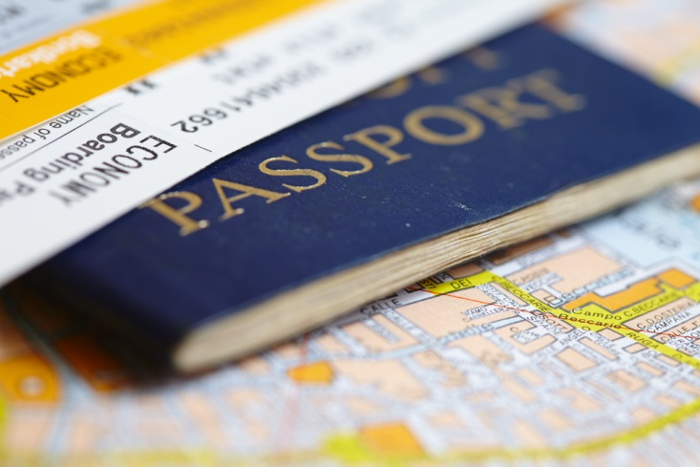
2.7 Facilitate check-in of departing passengers at the terminal
Facilitate check-in of departing passengers may include:
Verifying with passengers that they have completed the required documentation to facilitate their departure
Verifying and assisting passengers in complying with host country or carrier departure requirements
Notes:
Discuss each point relating to your current country or location.
Inexperienced travellers may need deeper clarification of this process.
Complete the activity below
Instructions: Ask learners to divide into 2-3 groups of 6-10. Work onto a flip chart or whiteboard so everyone is involved and develop a checklist of steps and processes required for checking in visitors at the transport terminal (note; this could be air, sea, rail, coach). Scenario begins at the point of the transfer transport arriving at the departing terminal.
Could allocate a different scenario for each work group. Private family tour 2 adults 2 kids travelling to New Zealand, Guided tour group of 20 European business visitors returning to their home countries of France, Germany, Italy. A tour group of 36 elderly Americans returning home to Florida, Family group consisting of 3 families. 6 adults 9 kids ages 3-15 travelling to Mexico.
Purpose: To establish learners’ current knowledge of practices at their workplace and tie in with the PC 2.7
Duration: 15 mins to discuss and present for each group.
Now that all of the visitors are being transported to the transport terminal, you are now to check them in at the respective counter. Before proceeding, do one last headcount to ensure all are there with their personal belongings.
Complete Work Projects for this Element from Trainee Manual as time allows either individually or in work groups. If no time then direct learners to complete as homework.

